Slide 1

Algorithms and Data Structures 2 CS 1501
Fall 2021
Sherif Khattab
ksm73@pitt.edu
(Slides are adapted from Dr. Ramirez’s and Dr. Farnan’s CS1501 slides.)

Slide 2
Announcements
Homework 2 and Lab 1 due this Friday
Lab 1 had a typo: please use nextCoords. instead of nextCoordinates.
Assignment 1 due on 10/1
Code handouts on Canvas
Isabella Mailer created a GroupMe for this class for students to discuss content and plan study sessions
https://groupme.com/join_group/70805571/tsR1V68z
Michael G. Wells Competition
https://www.innovation.pitt.edu/michael-g-wells-competition/
Games 4 Social Impact Hackathon
https://www.games4socialimpact.pitt.edu/
Get (Re)involved on Campus
https://www.pitt.edu/pittwire/features-articles/get-reinvolved-campus

Slide 3
Last lecture …
Backtracking
General structure
8 Queens
Boggle Game

Slide 4
This Lecture
TreeADT
Basic defnitions
Tree traversal

Slide 5
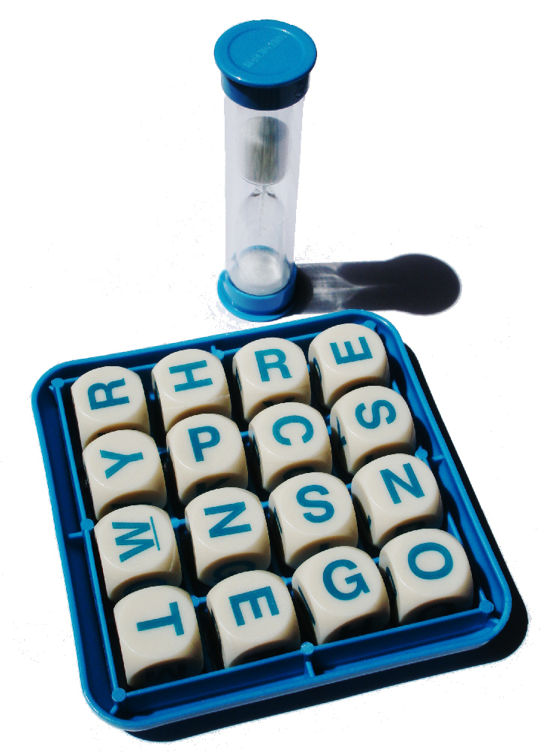
Where do we prune?
Can’t go past the edge of the board
Can’t reuse the same cells in the board
Each letter added must lead to the prefix of an actual word
Check the dictionary for each letter recursed to, if there is no word with the currently constructed string as a prefix, backtrack
Practically, this can be used for huge savings
Notes:
Need to define pruning rules
Can’t go past the edge of the board
Can’t reuse the same cells in the board
Each letter added must lead to the prefix of an actual word
Check the dictionary for each letter recursed to, if there is no word with the currently constructed string as a prefix, backtrack
Practically, this can be used for huge savings

Slide 6


Boggle Game: Decisions and Choices
Starting from a tile, the first decision to make is which adjacent tile to move to.
There are at most 8 possible choices to choose from
There is a decision to make out of each tile that we go through
A maximum of 15 decisions

Slide 7
Implementation concerns with Boggle
Constructing the words over the course of recursion will mean building up and tearing down strings
Moving forward adds a new character to the current word string
Backtracking removes the most recent character
Basically pushing/popping to/from a string stack
Push/Pop stack operations are generally Θ(1)
Unless you need to resize, but that cost can be amortized
Java Strings, however, are immutable
s = new String(“Here is a basic string”);
s = s + “ this operation allocates and initializes all over again”;
Becomes essentially a Θ(n) operation
Where n is the length of the string

Slide 8
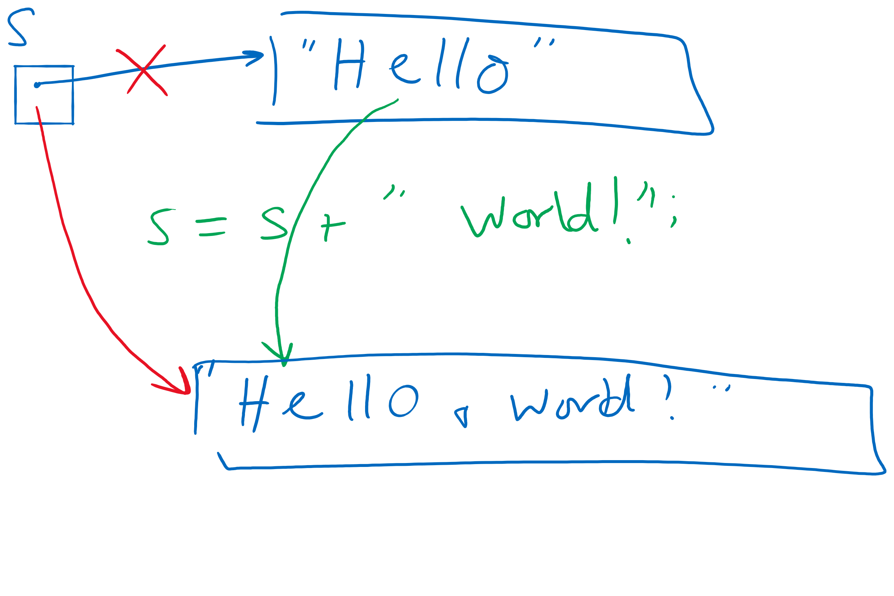
Concatenating to A String Object

Slide 9
StringBuilder to the rescue
append() and deleteCharAt() can be used to push and pop
Back to Θ(1)!
Still need to account for resizing, though…
StringBuffer can also be used for this purpose
Differences?
Notes:
StringBuffer is synchronized
StringBuilder is not

Slide 10
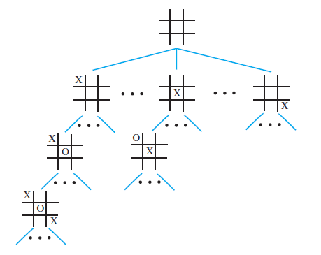
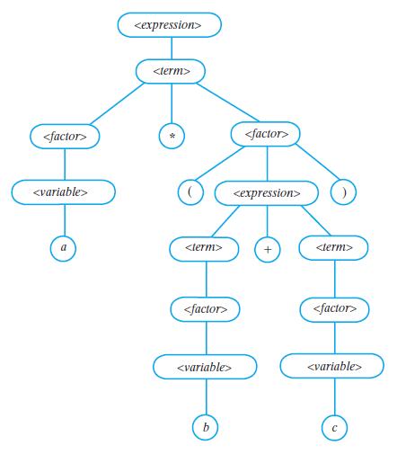
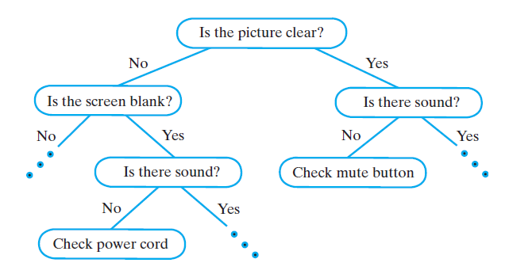
Examples of Trees
Game Tree
Parse Tree
Decision Tree

Slide 11
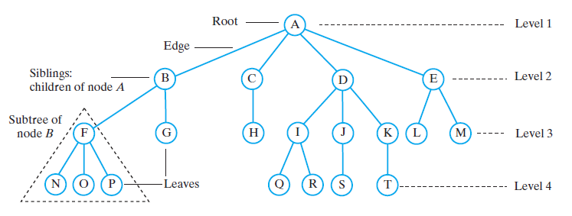
Tree Terminology

Slide 12
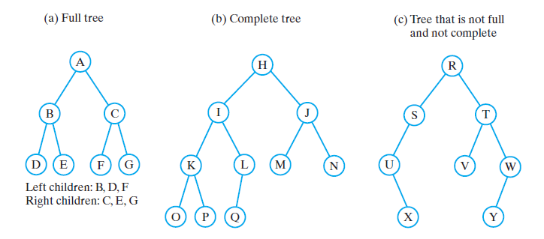
Binary Trees

Slide 13
Traversals of a Binary Tree
Preorder traversal
Visit root before we visit root’s subtrees
Inorder traversal
Visit root of a binary tree between visiting nodes in root’s subtrees.
Postorder traversal
Visit root of a binary tree after visiting nodes in root’s subtrees
Level-order traversal
Begin at root and visit nodes one level at a time

Slide 14
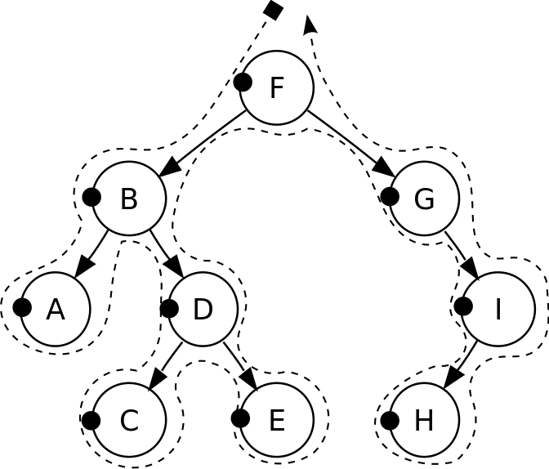
Pre-order traversal
Notes:
F, B, A, D, C, E, G, I, H
Seen before when we talked about marshalling huffman tries to the compressed file
Good for evaluating Polish notation

Slide 15
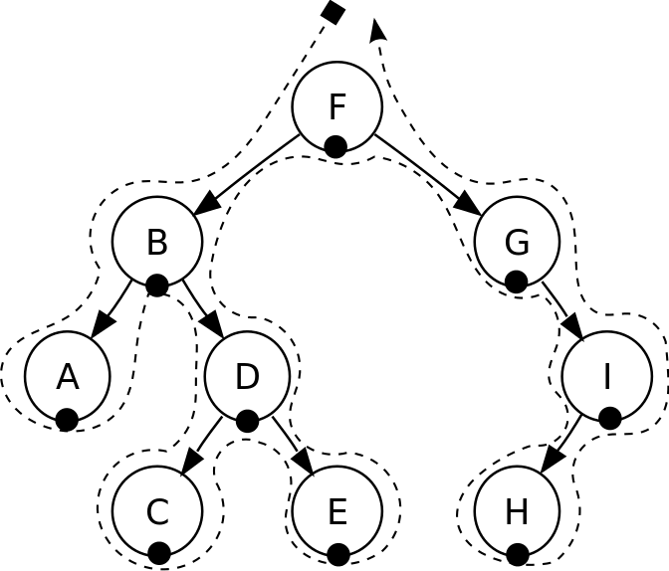
In-order traversal
Notes:
A, B, C, D, E, F, G, H, I
Seen when we wanted to enumerate all values stored in a B-tree (motivating the need for a B+tree)
Good for sorted ordering (if dealing with sorted data structure)

Slide 16
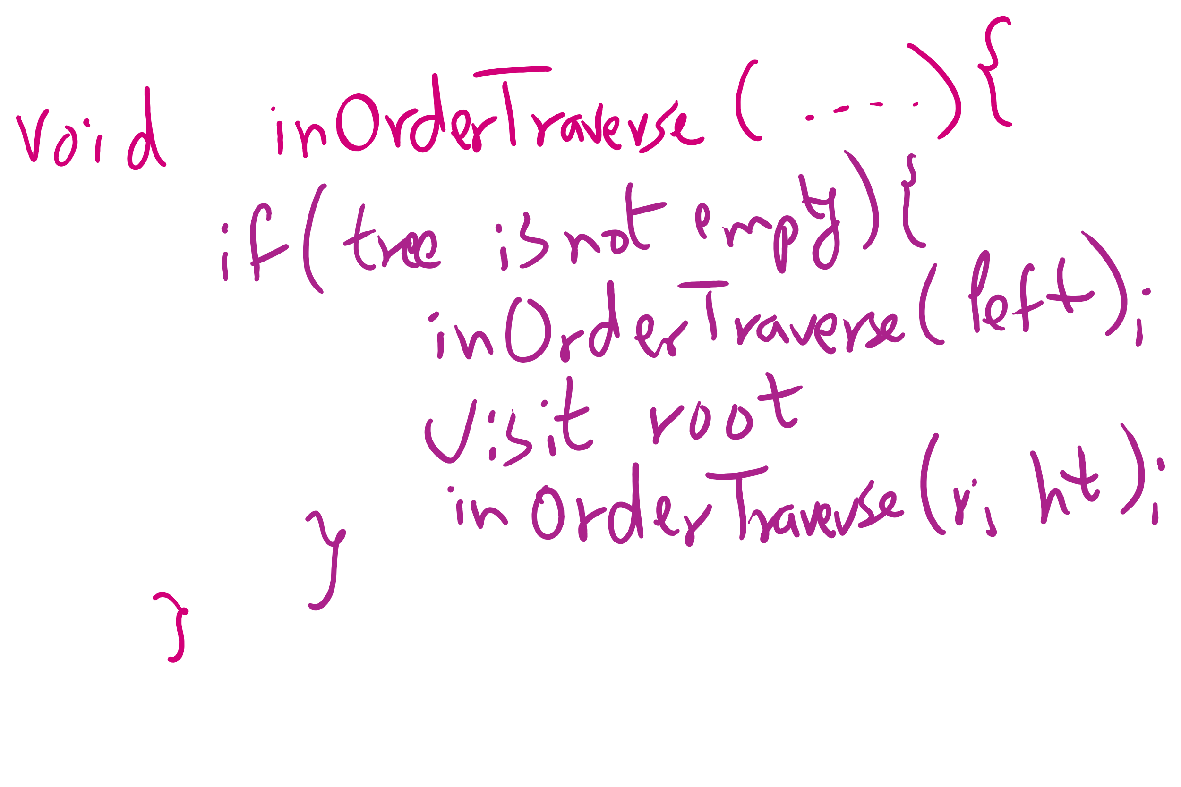
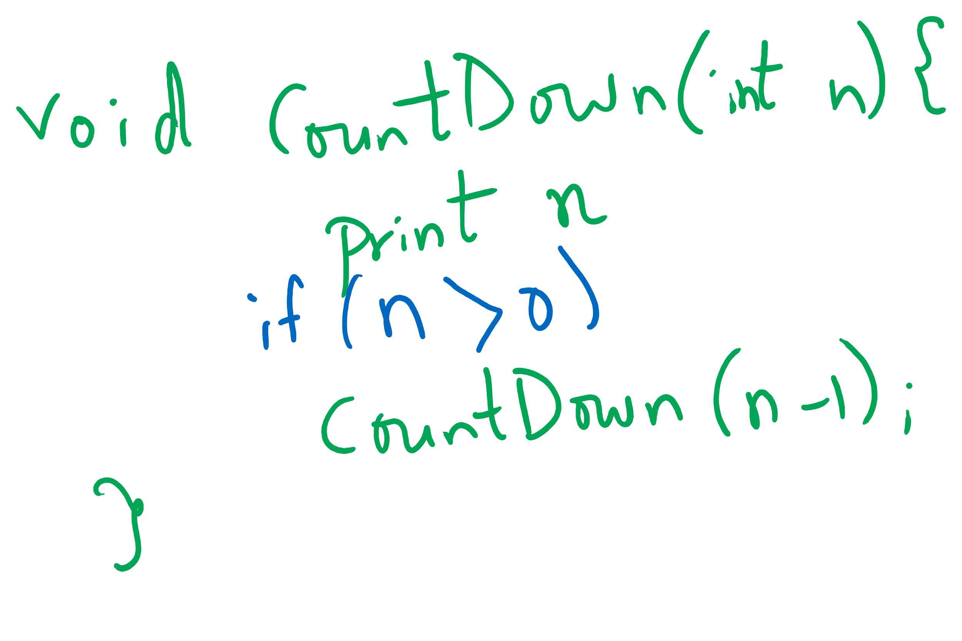
Tail-recursive Examples

Slide 17
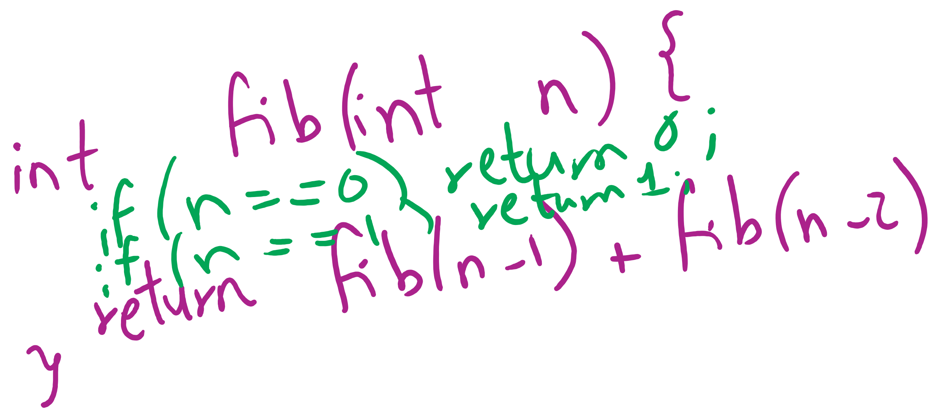
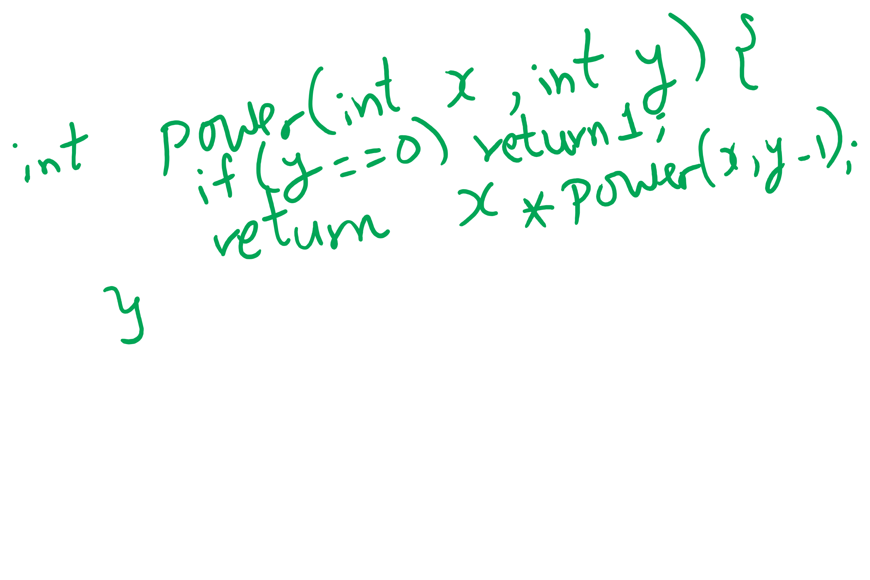
Non-tail recursive Examples

Slide 18
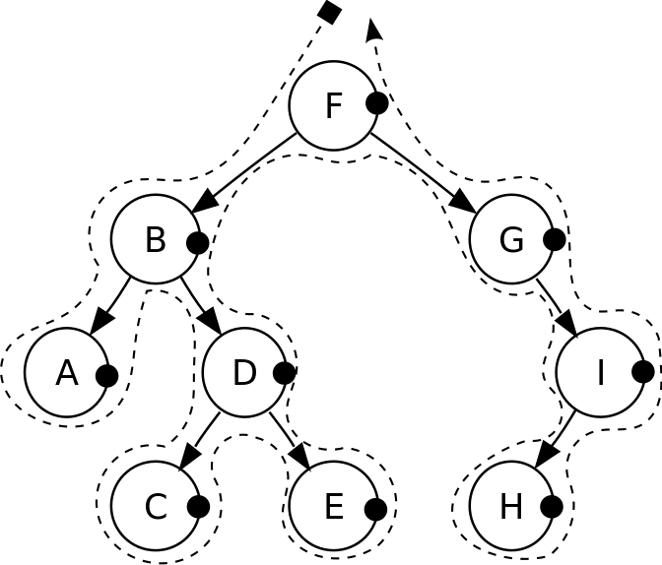
Post-order traversal
Notes:
A, C, E, D, B, H, I, G, F
Good for reverse Polish notation

Slide 19
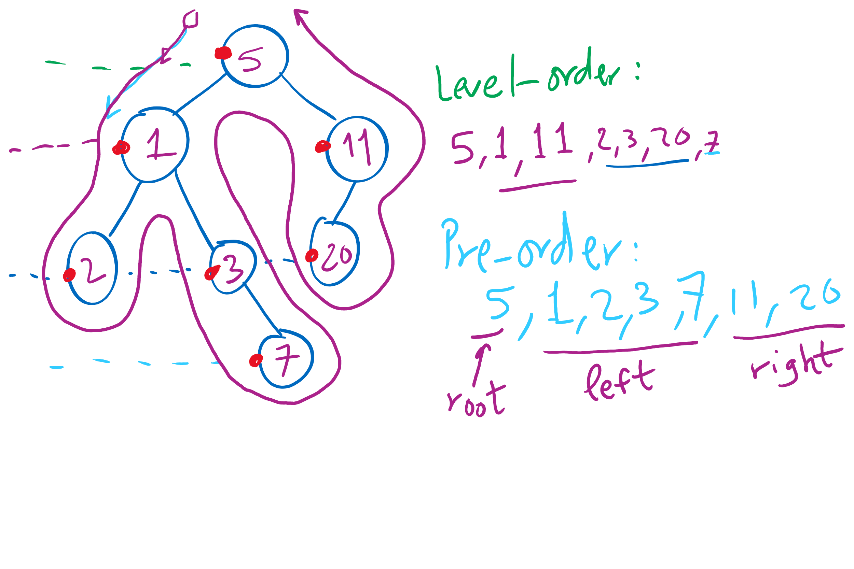
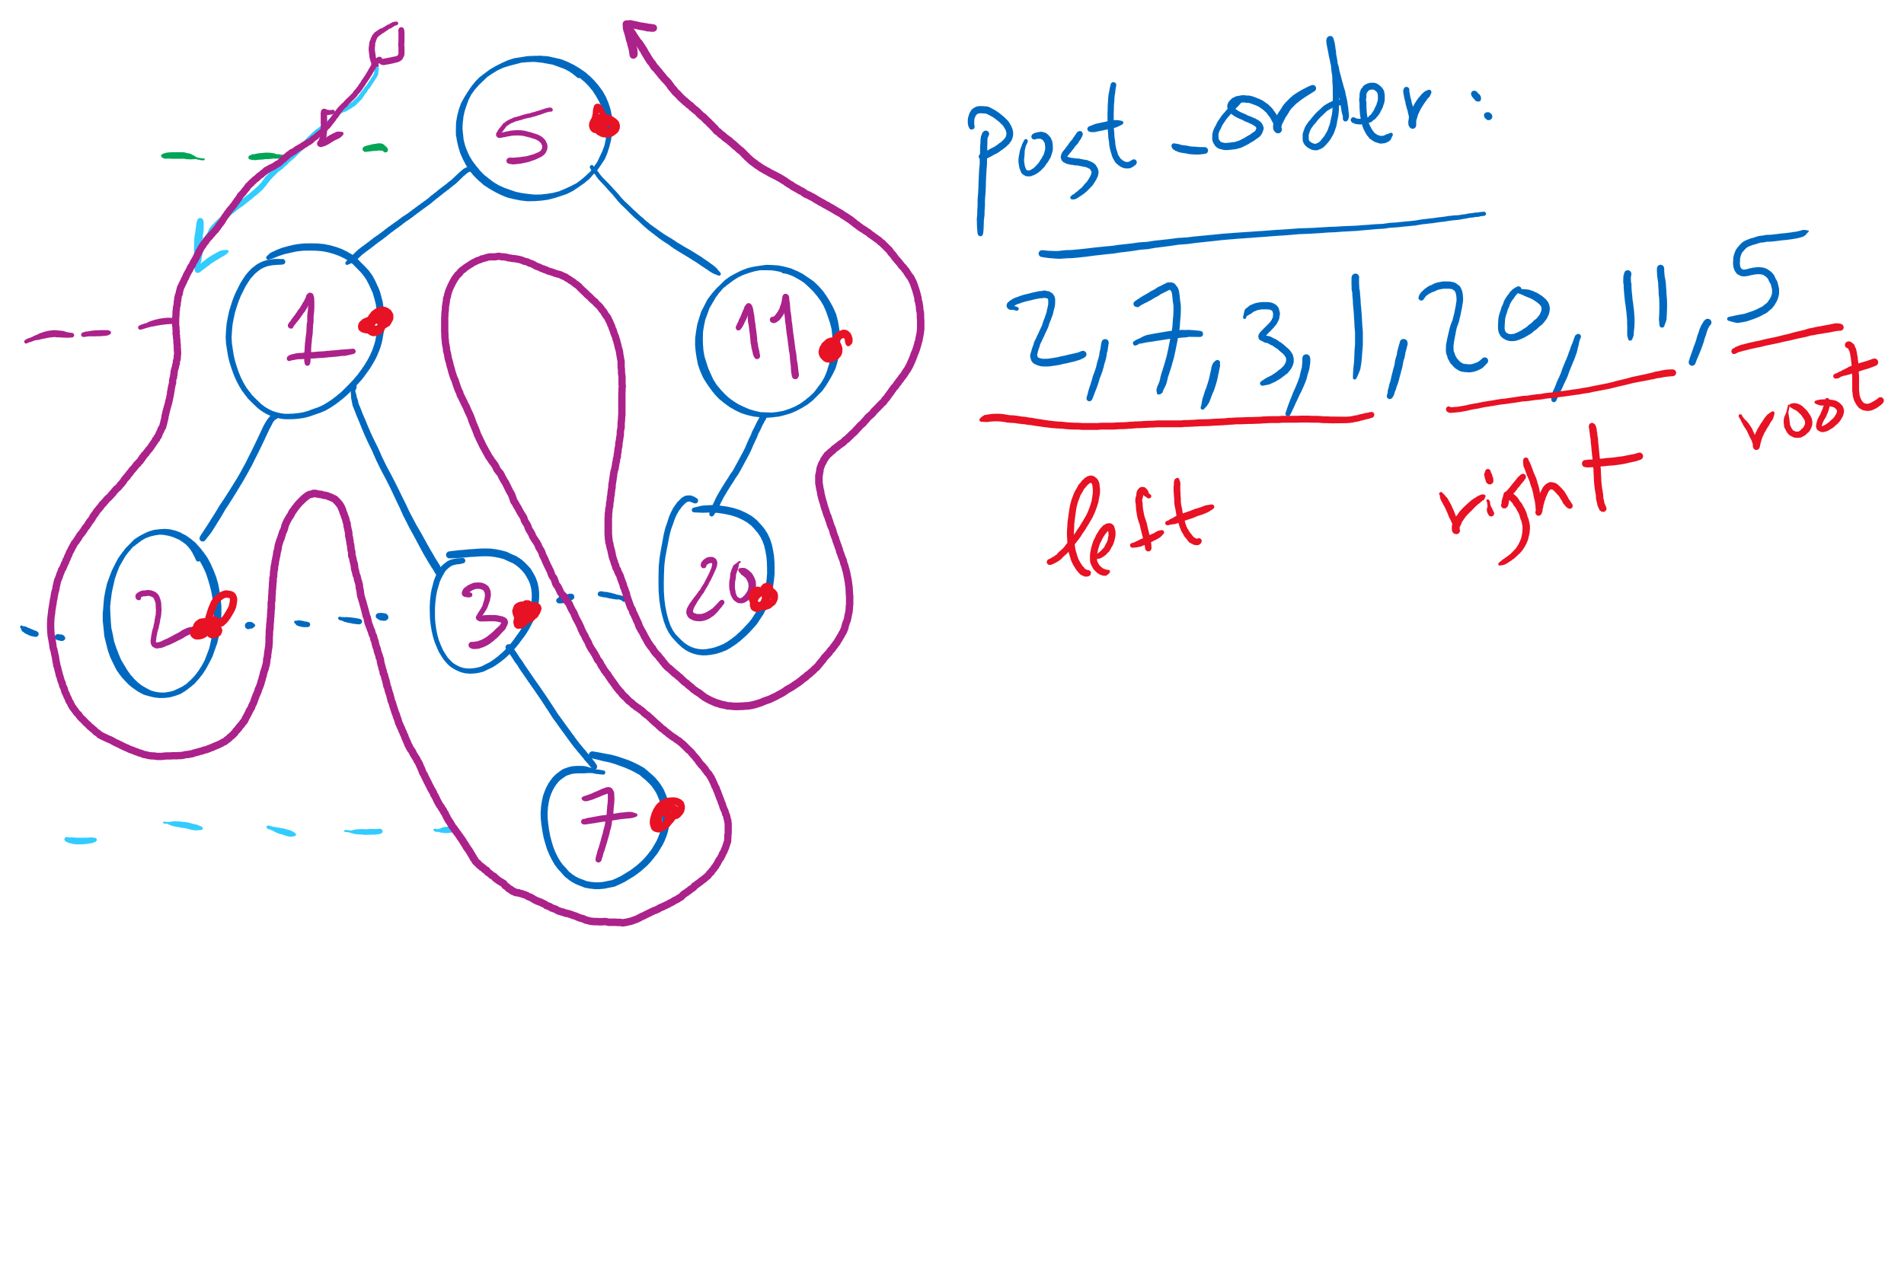
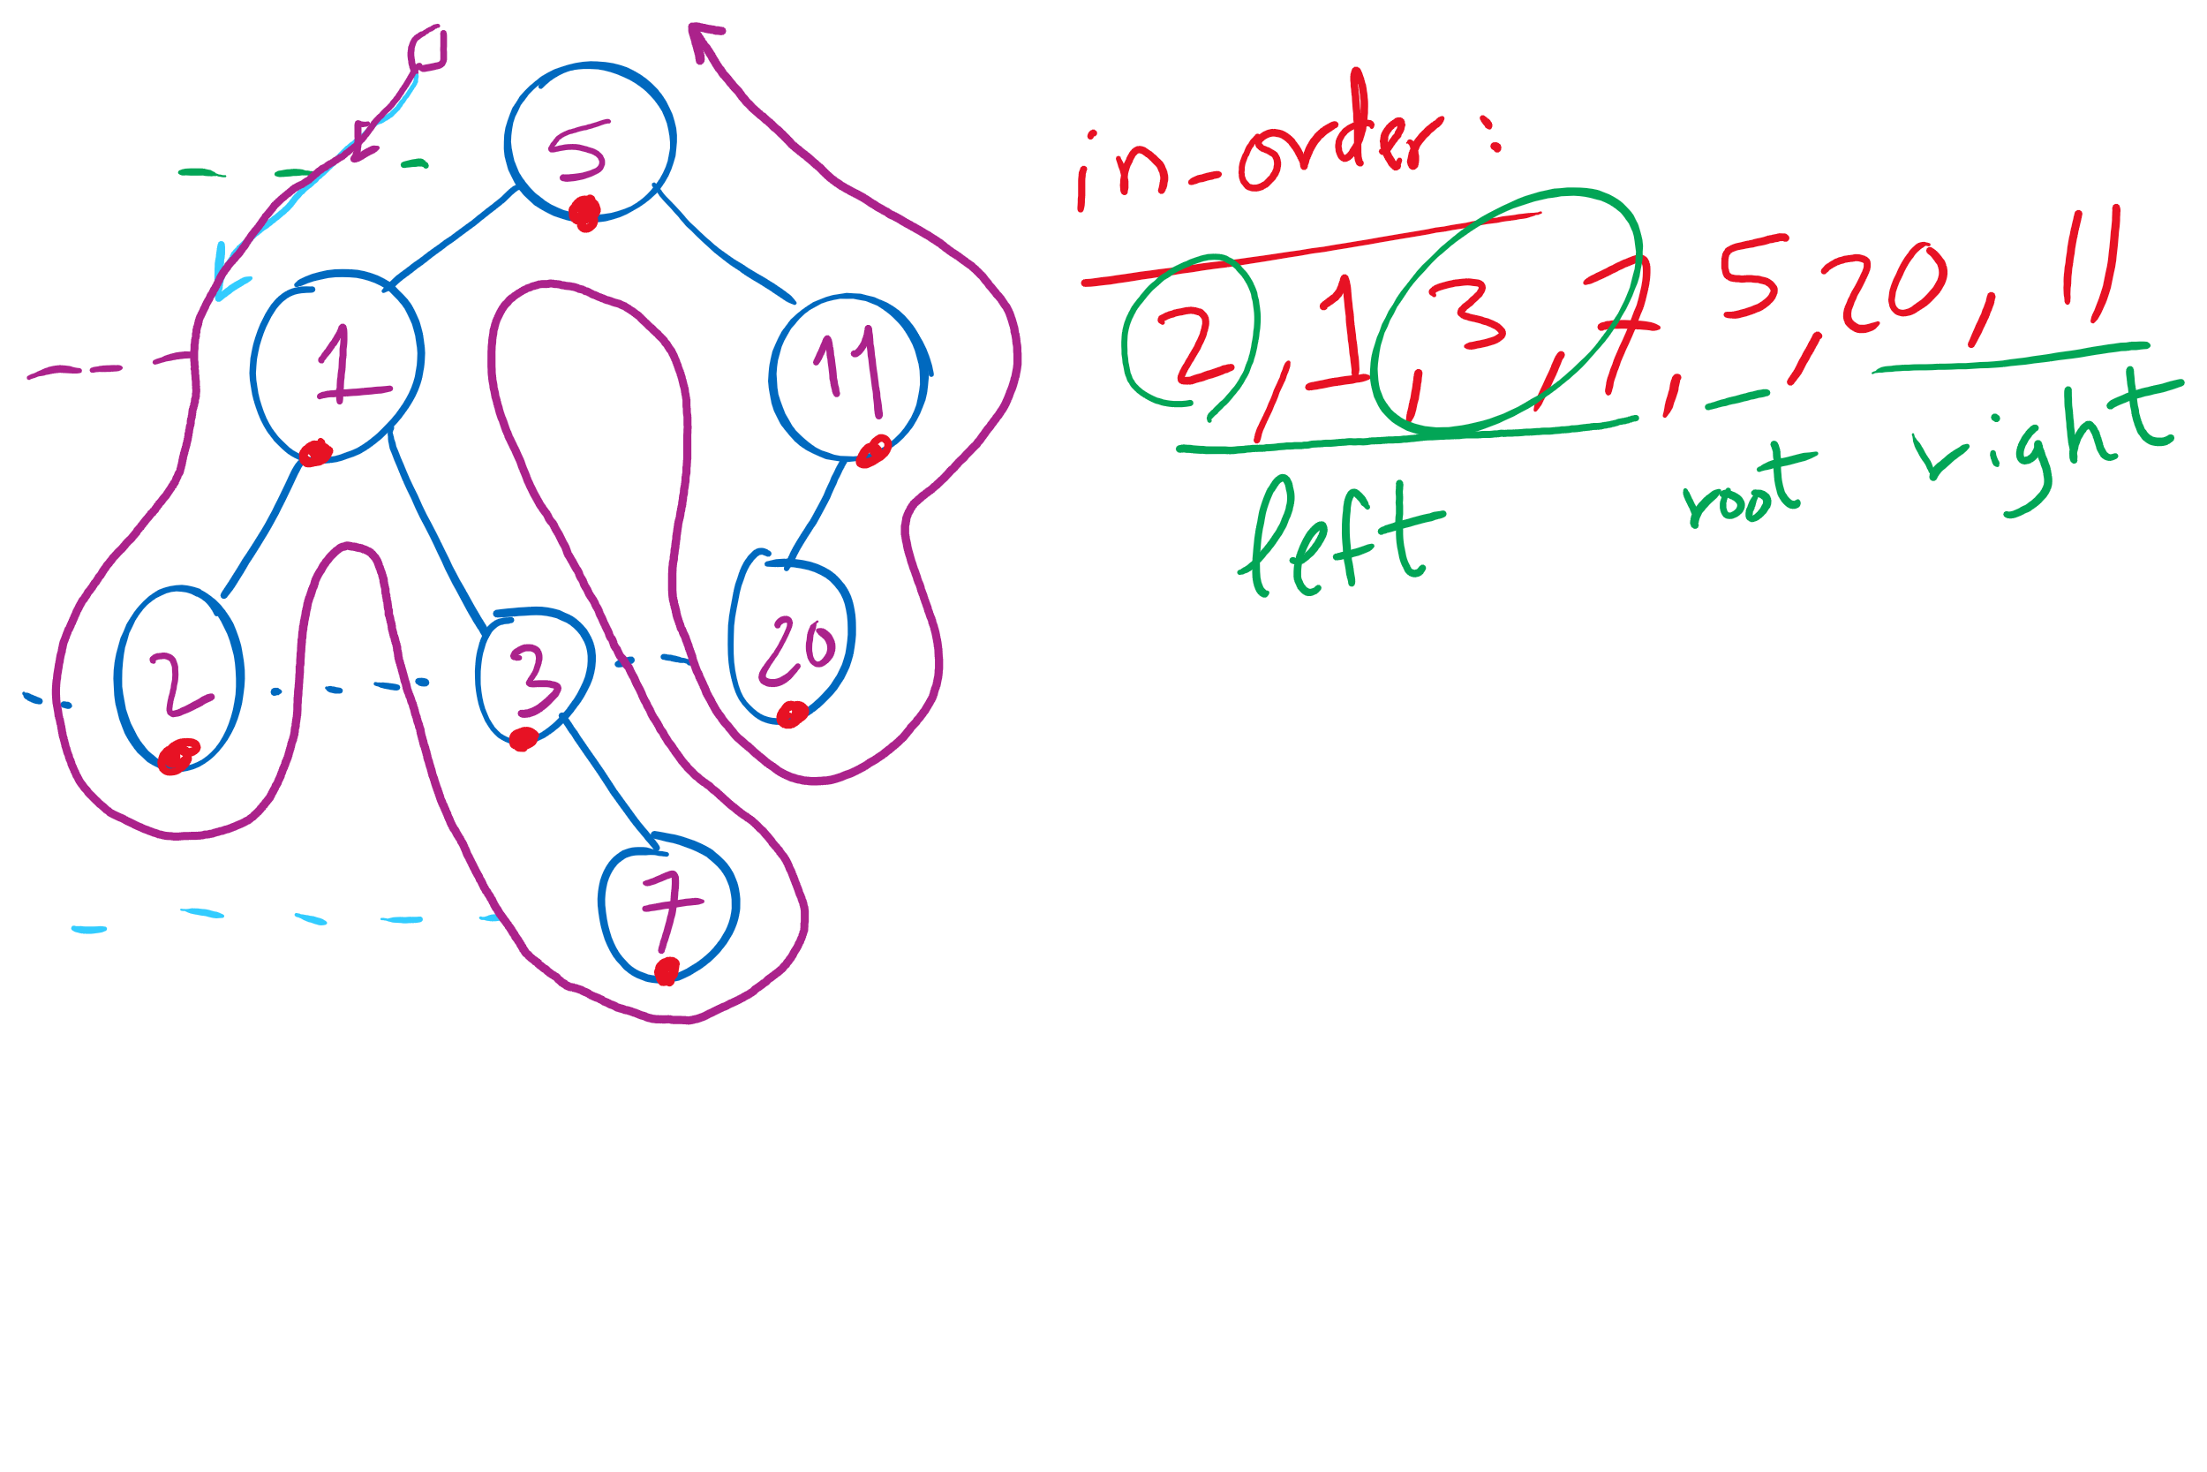
Tree Traversal Example 1

Slide 20
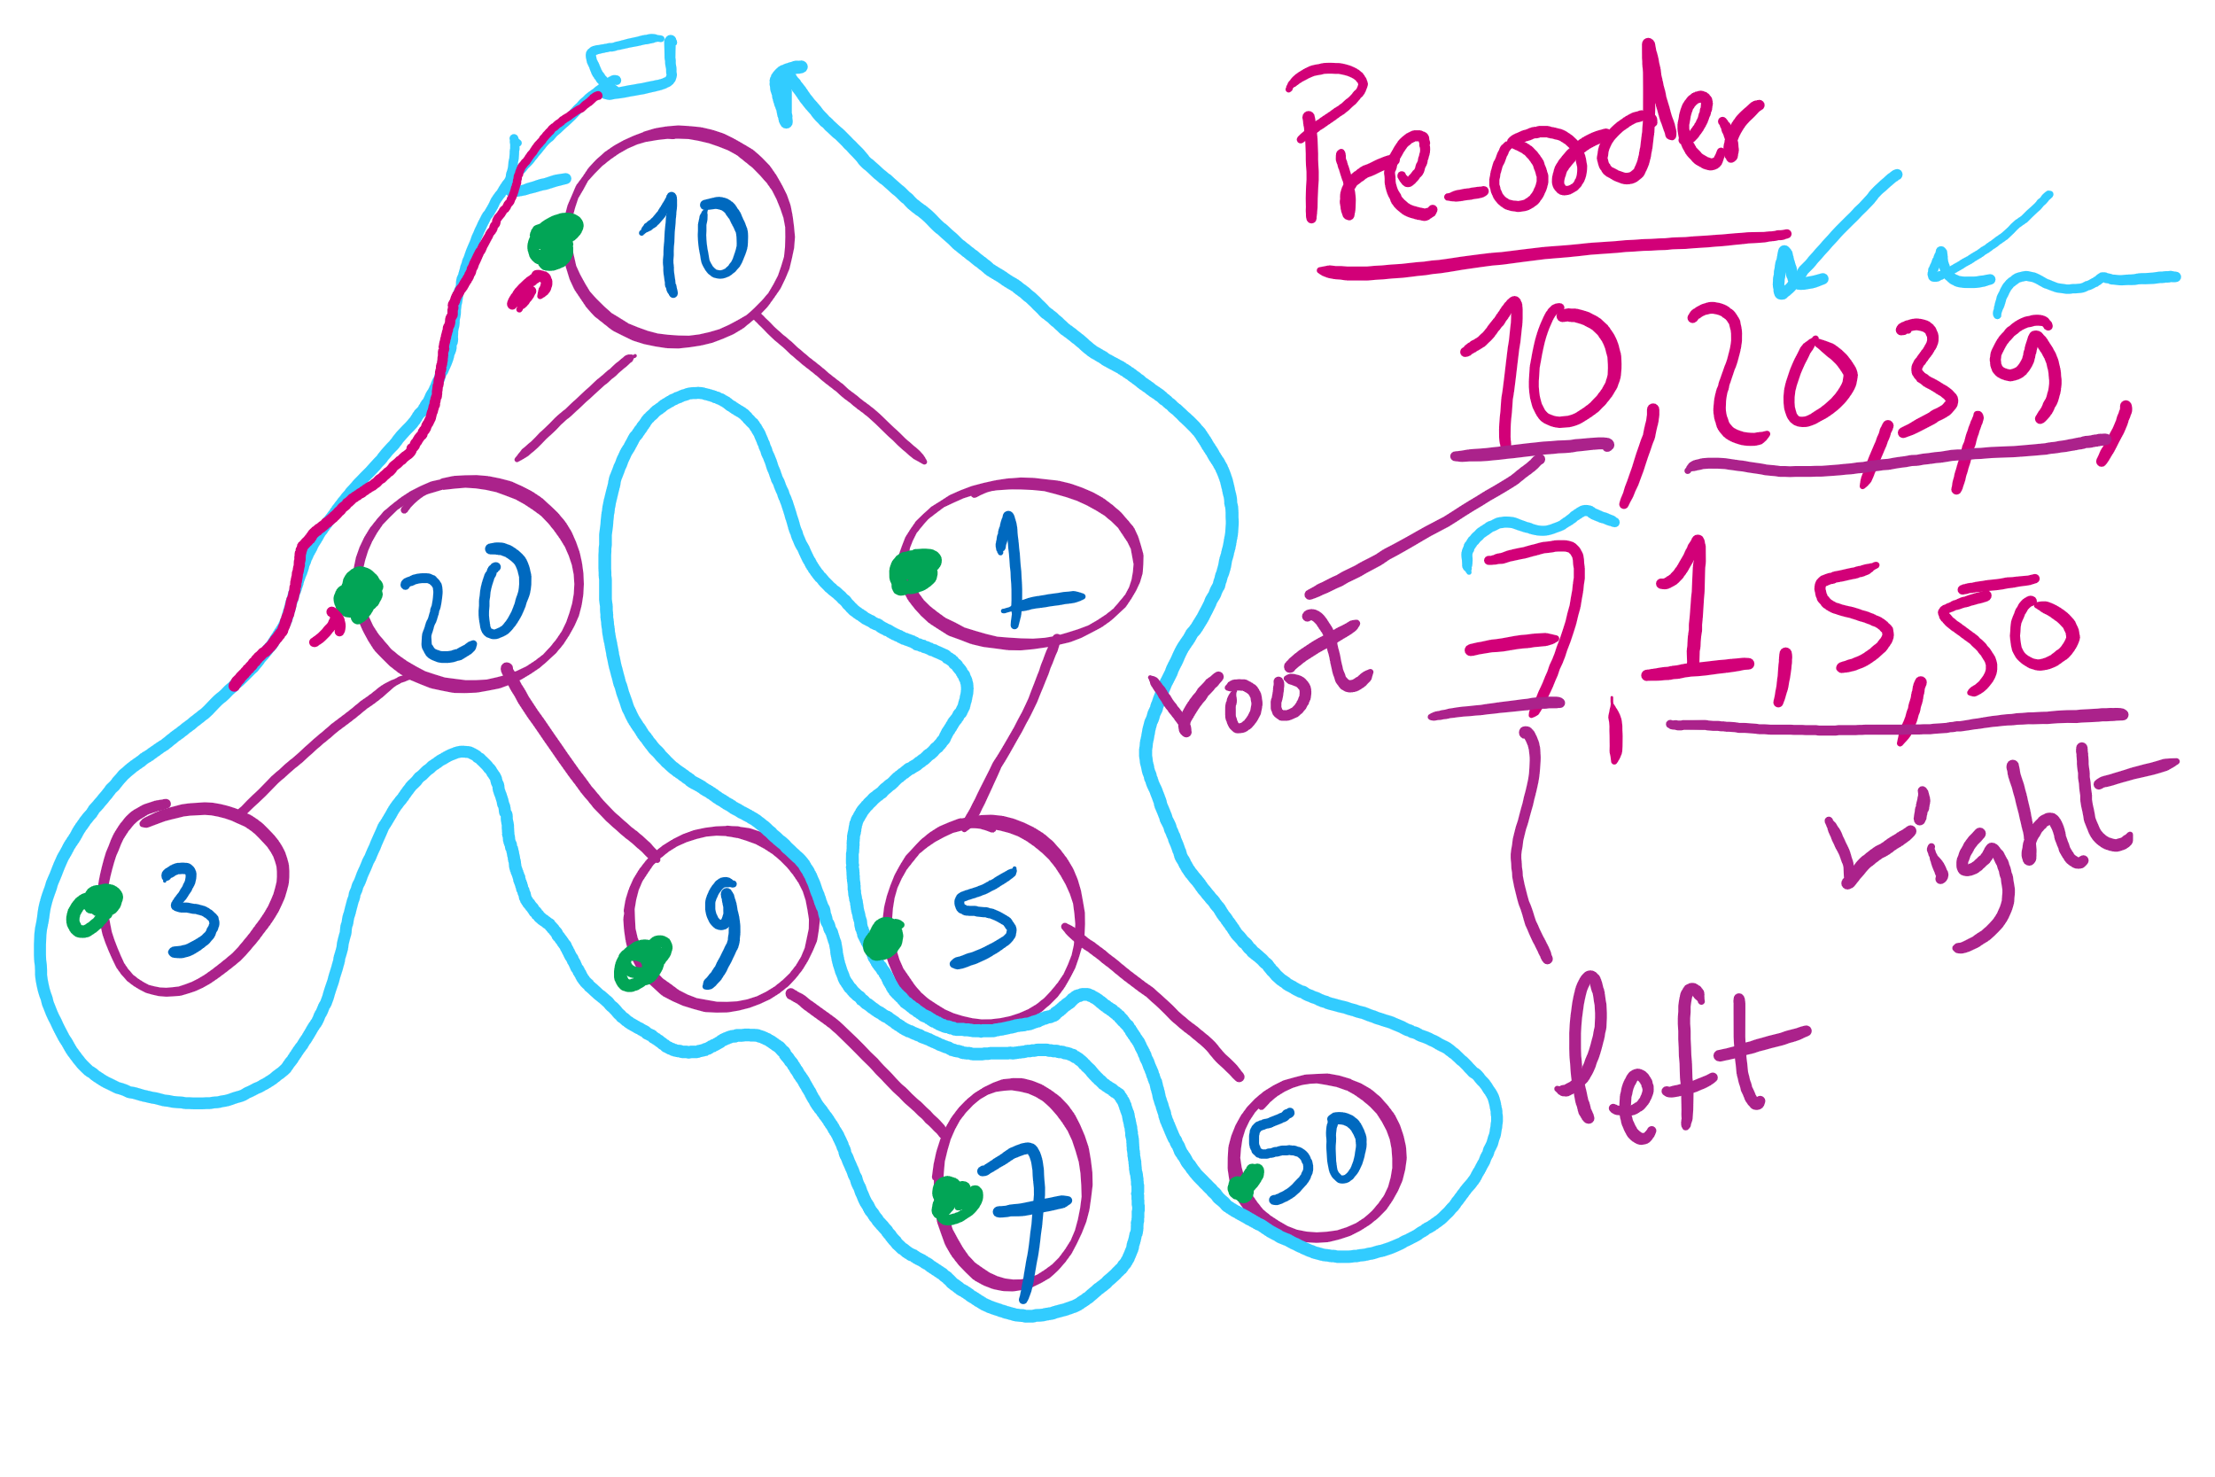
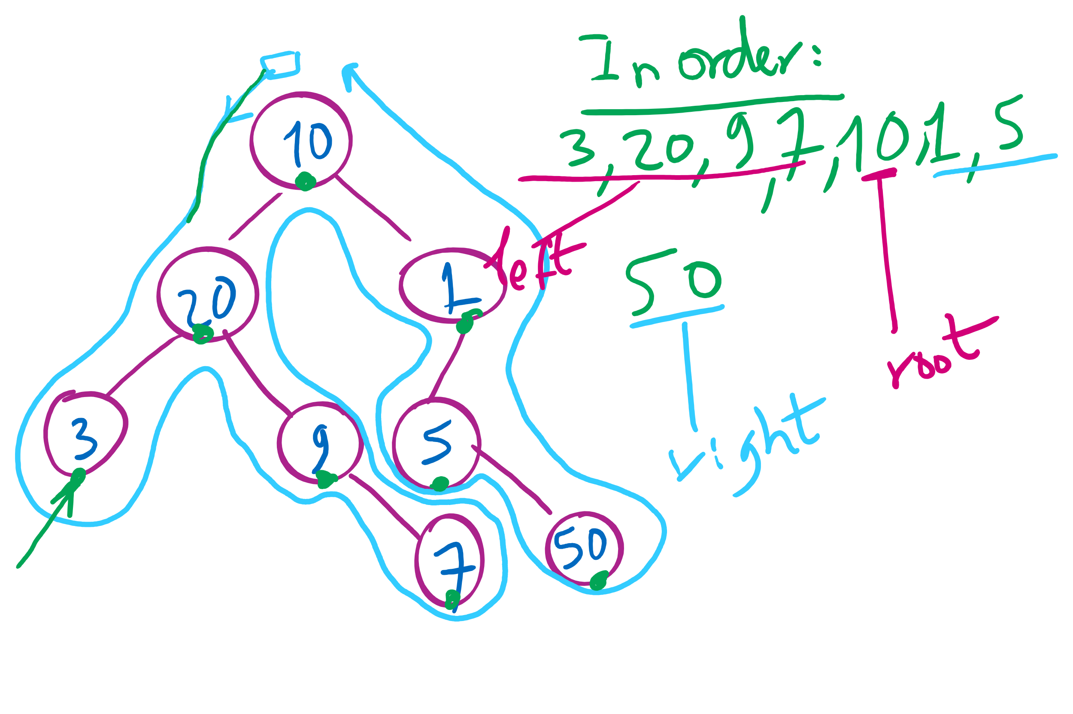
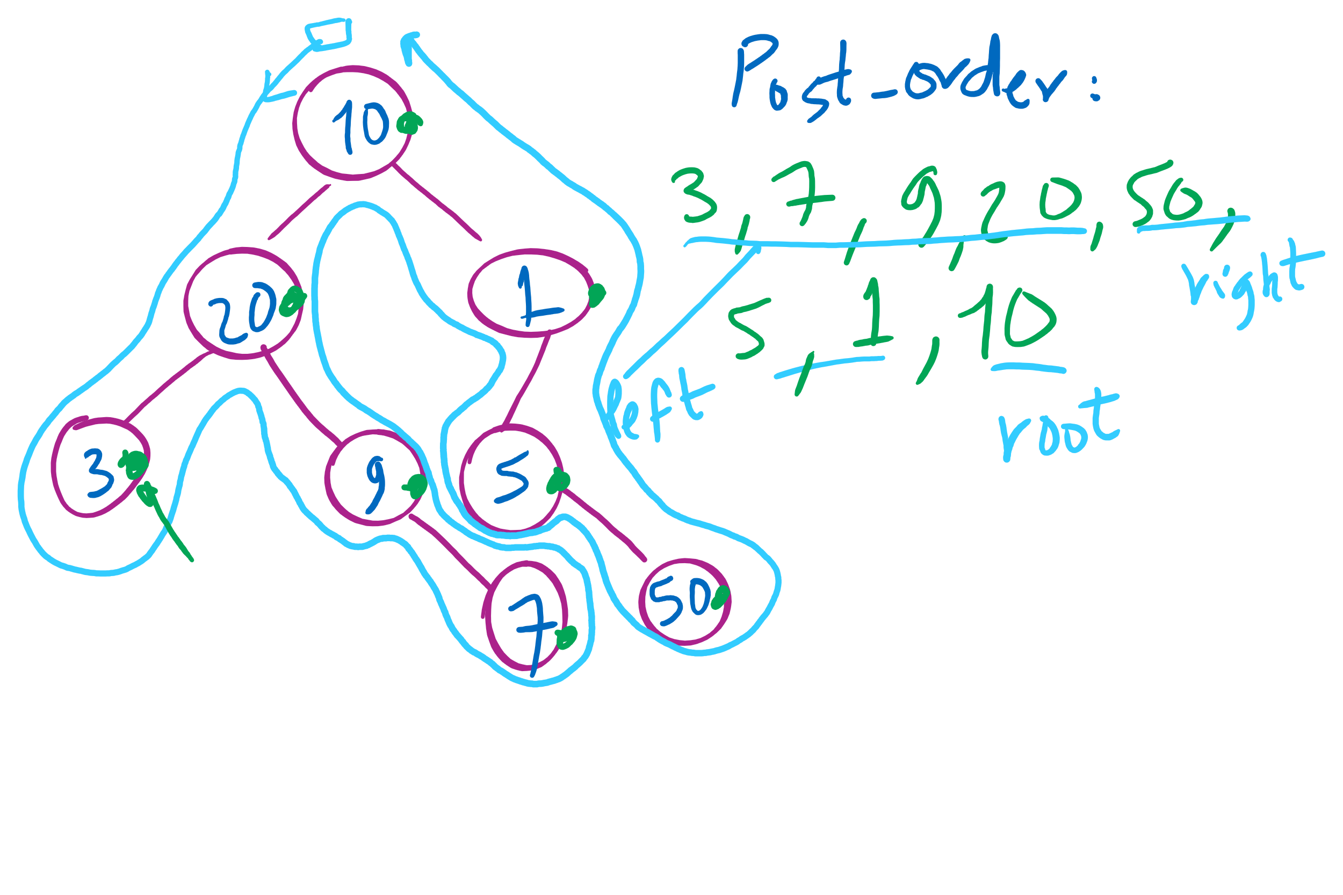
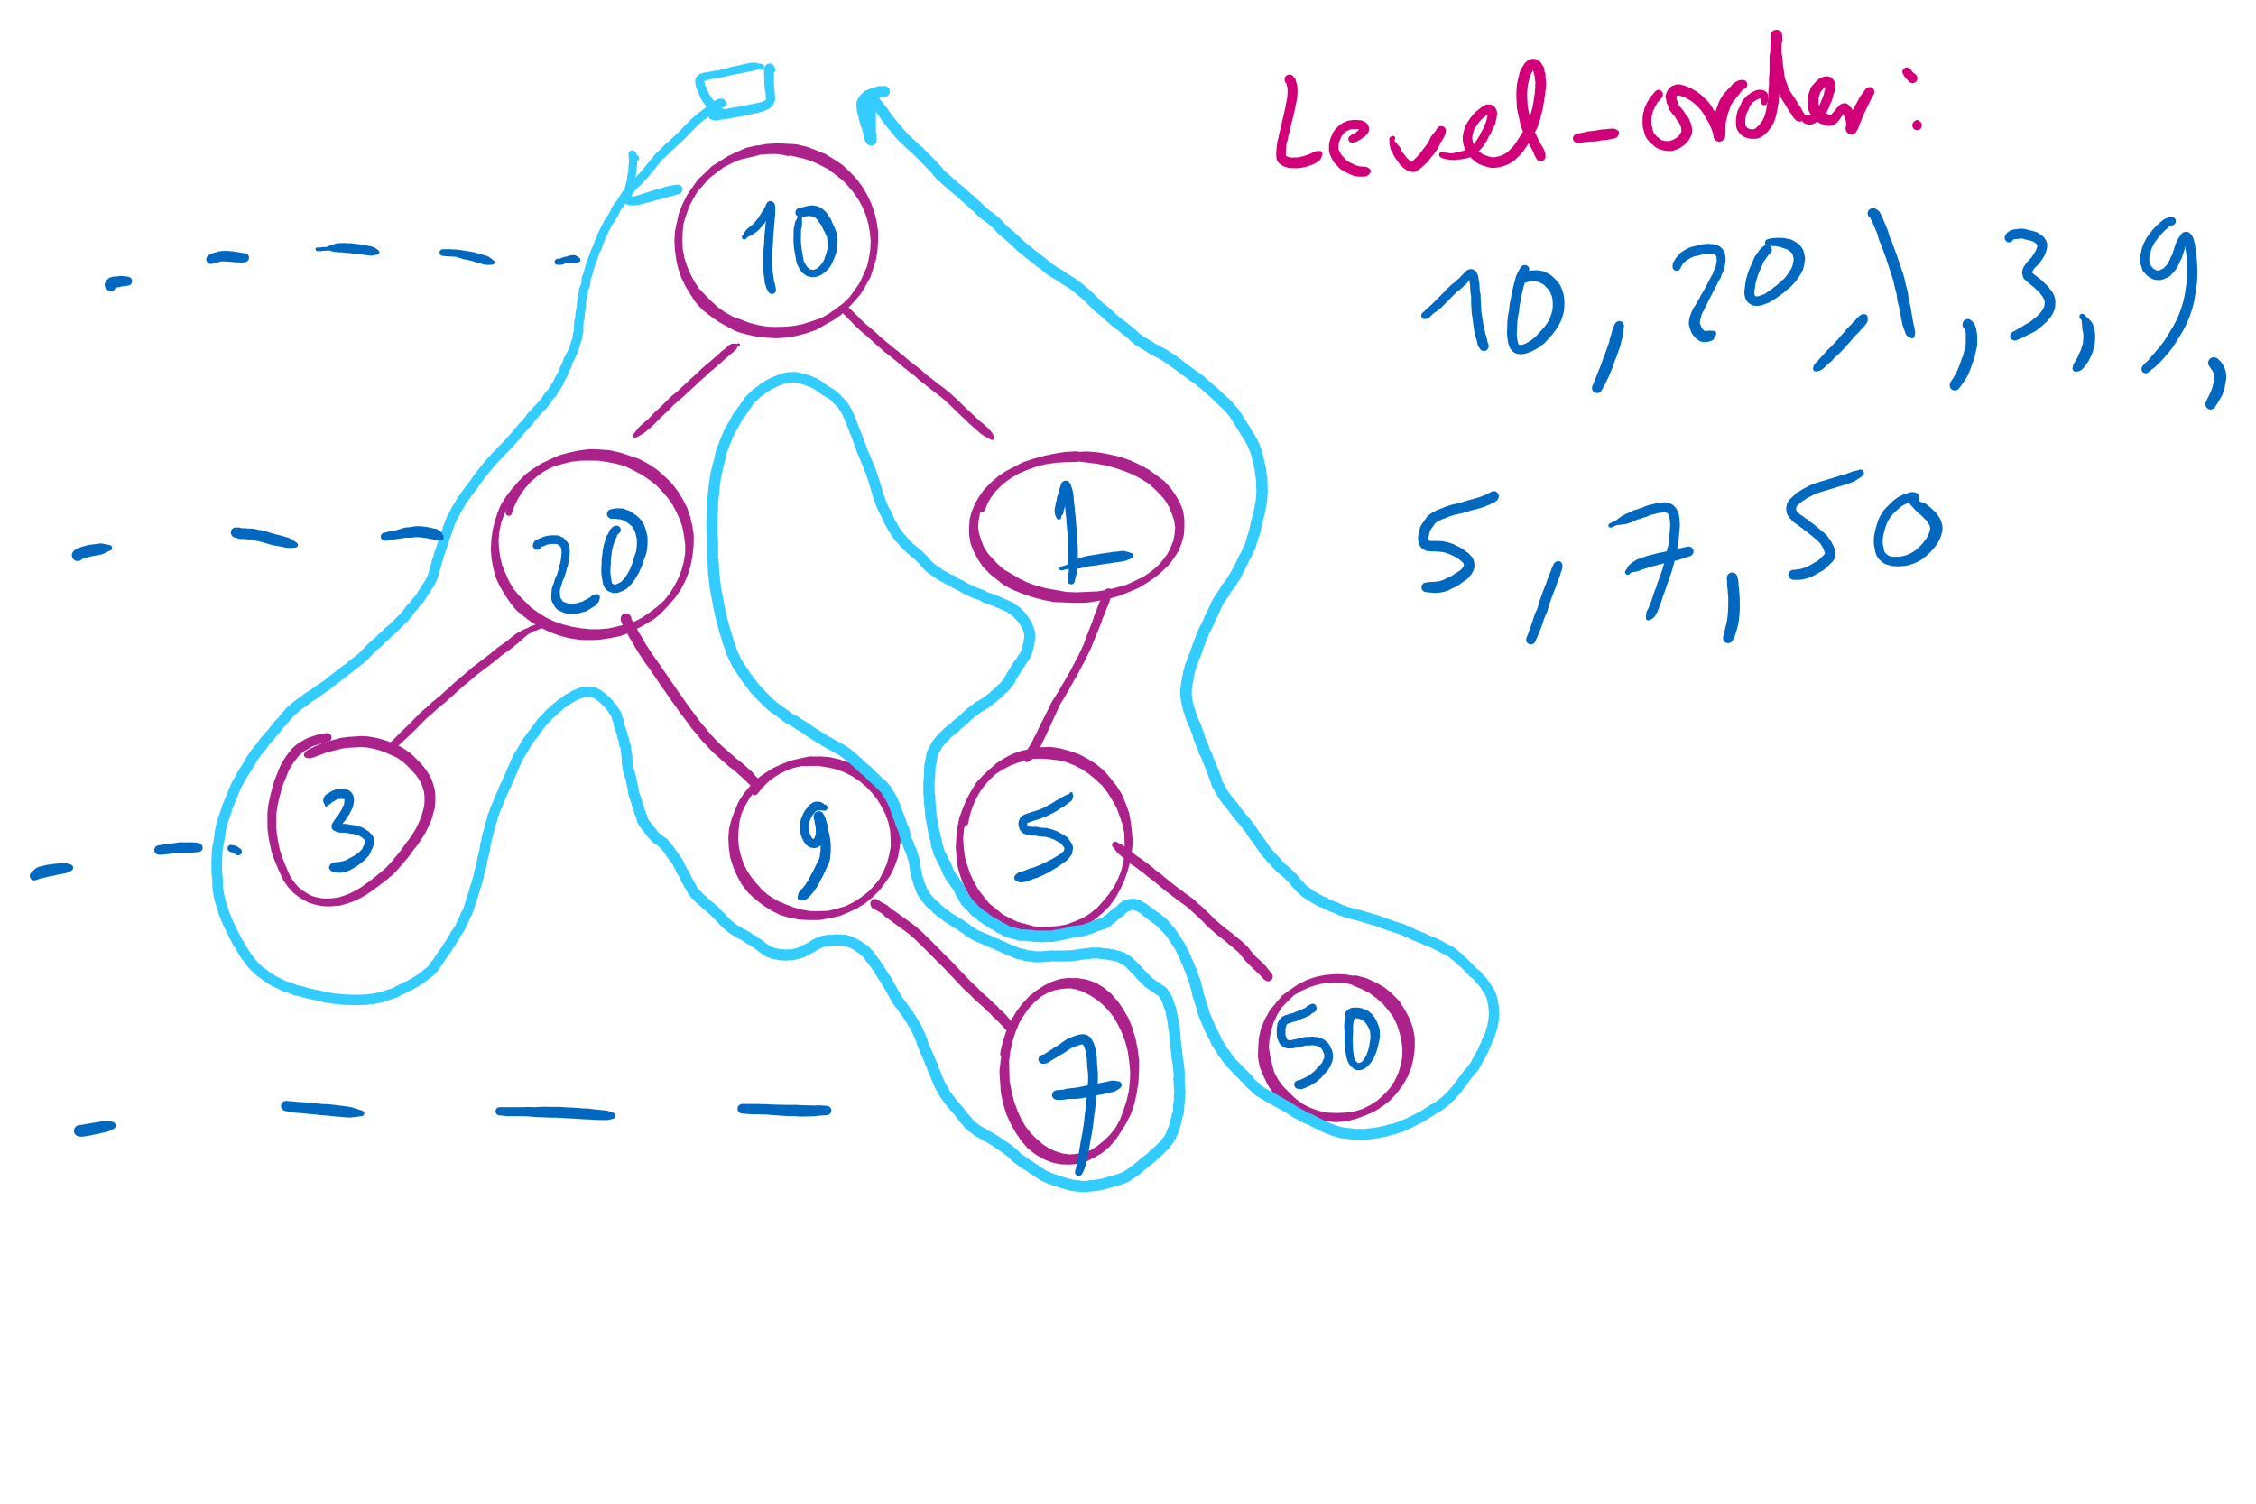
Tree Traversal Example 2

Slide 21
Please submit your reflections by using the CourseMIRROR App
If you are having a problem with CourseMIRROR, please send an email to coursemirror.development@gmail.com
Notes:
All right!
Upcoming Due Dates at A Glance

